Slide 1

Raspberry Pi
22AIE211 Introduction To Communication & IoT

Slide 2
What is Raspberry Pi?
Computer in your palm.
Single-board computer.
Microprocessor.
Low cost.
Easy to access.

Slide 3
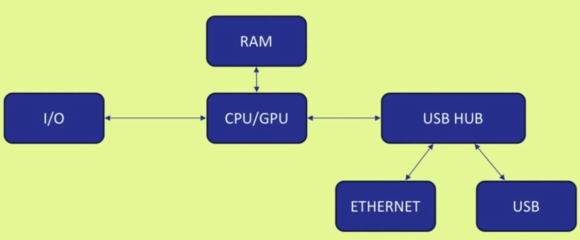
Basic Architecture

Slide 4
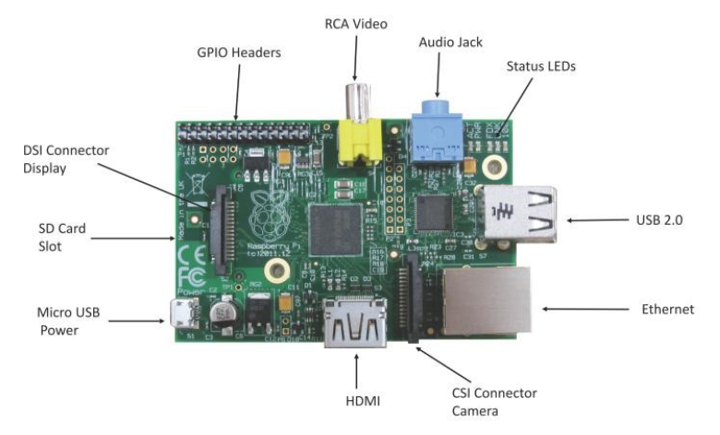
Raspberry Pi
Raspberry Pi 5 vs Pi 4: The Definitive Comparison & Review

Slide 5
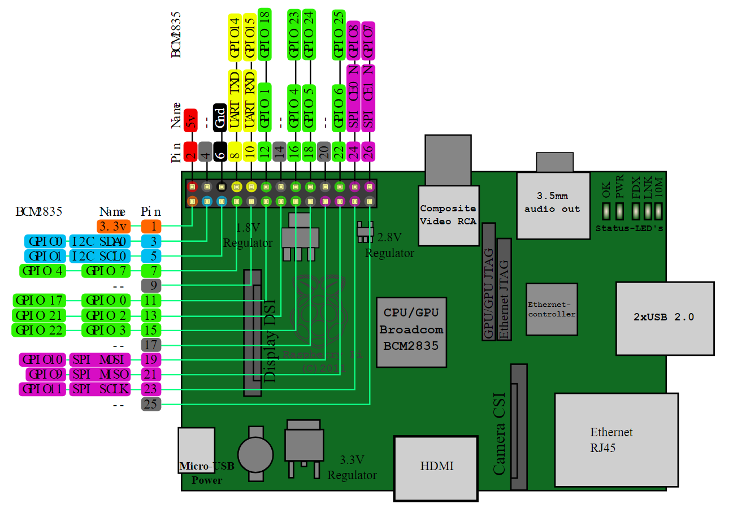
Raspberry Pi Pin Configuration
Source: Raspberry Pi PCB Pin Overview, Wikimedia Commons (Online)

Slide 6
Basic Set up for Raspberry Pi
HDMI cable.
Monitor.
Key board.
Mouse.
5volt power adapter for raspberry pi.
LAN cable .
Min- 2GB micro sd card

Slide 7
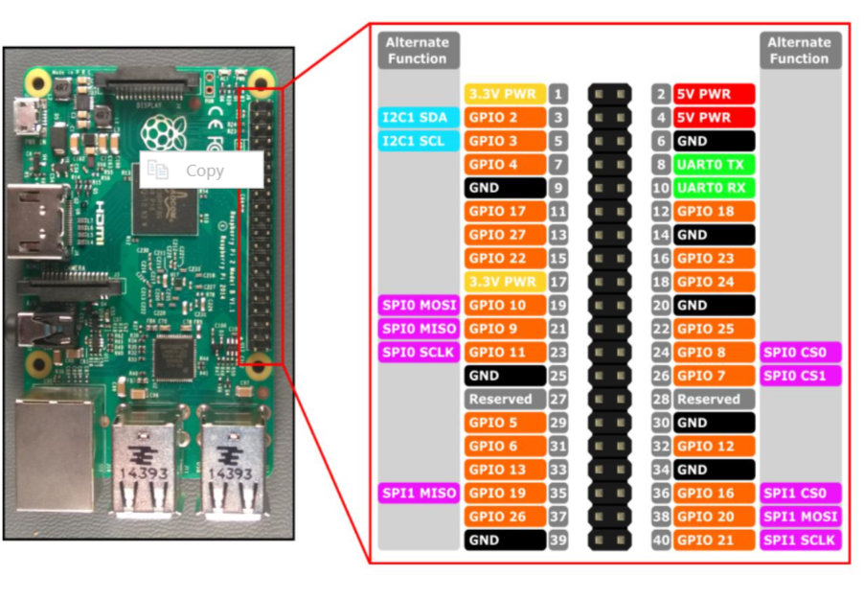
Raspberry Pi Pin Configuration

Slide 8
Raspberry Pi GPIO
Act as both digital output and digital input.
Output: turn a GPIO pin high or low.
Input: detect a GPIO pin high or low.
What are GPIO pins on Raspberry Pi? – RaspberryTips

Slide 9
Operating System
Official Supported OS :
Raspberry Pi OS (previously called Raspbian)
NOOBS
Some of the third party OS :
UBUNTU mate
Snappy Ubuntu core
Windows 10 core
Pinet
Risc OS

Slide 10
Raspberry Pi Setup
Download Raspbian:
Raspberry Pi Imager is the quick and easy way to install Raspberry Pi OS and other operating systems to a microSD card, ready to use with your Raspberry Pi.
Download latest Raspbian image from raspberry pi official site:
https://www.raspberrypi.org/downloads/
• Unzip the file and end up with an .img file.
Raspberry Pi OS Setup
Write Raspbian in SD card :
• Install “Win32 Disk Imager” software in windows machine .
• Run Win32 Disk Imager
• Plug SD card into your PC
• Select the “Device”
• Browse the “Image File”(Raspbian image)
• Write

Slide 11
Programming
Default installed :
Python
On Raspberry Pi OS Desktop, the Thonny Python IDE is installed by default. How to Learn to Program in Python with a Raspberry Pi? – RaspberryTips
• C
• C++
• Java
• Scratch
• Ruby

Slide 12
Summary
Raspberry pi overview

